Slide 1
Workshop on Synopsys ARC CPU with TensorFlow Lite
Tutorial 1 – Environment Installation
主辦單位：國立清華大學電機系、新思科技
協辦單位：智慧製造電子應用聯盟
指導單位：教育部資訊及科技教育司

Slide 2
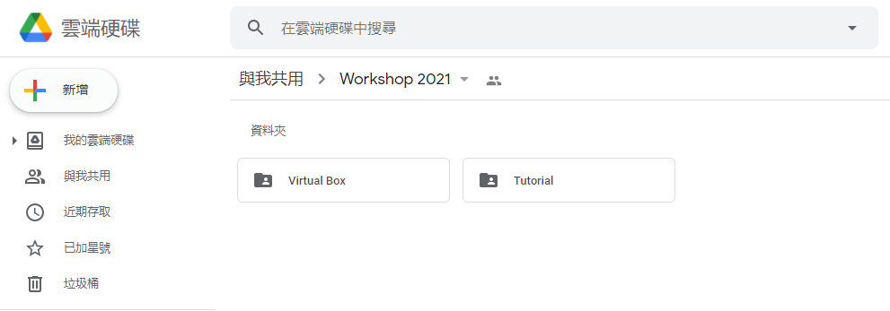
Download
Workshop Google Drive :
Copy the link below and search it in Google
Do not just click it!
https://drive.google.com/drive/folders/15gbcCkZDxUxflTWtAprPqlHkD5nbxKjP?usp=sharing

Slide 3
Install VirtualBox

Slide 4
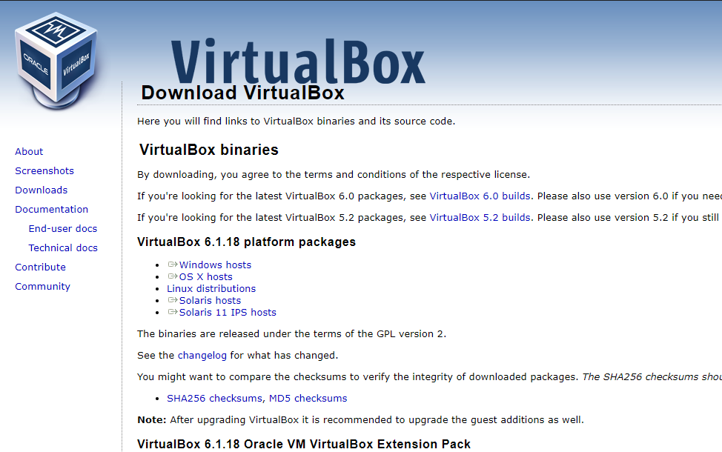
VirtualBox Installation

Slide 5
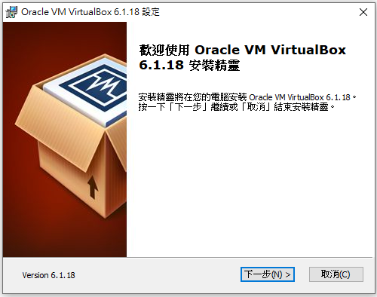
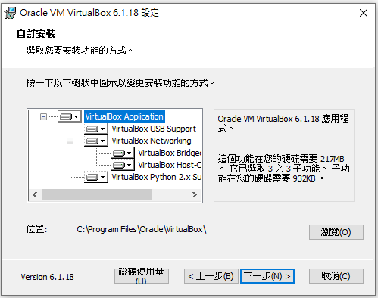
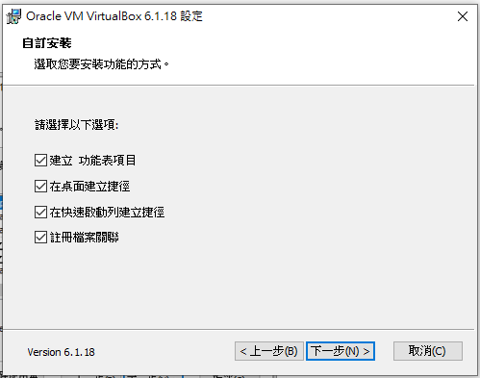
VirtualBox Installation

Slide 6
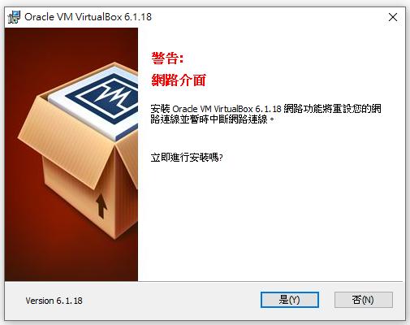
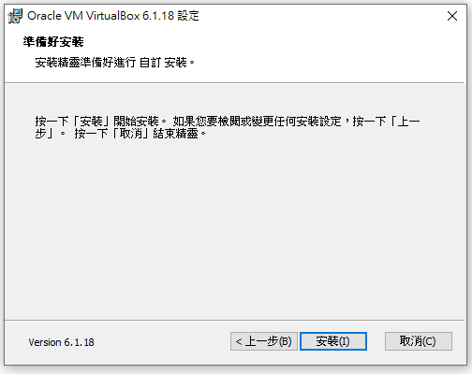
VirtualBox Installation

Slide 7
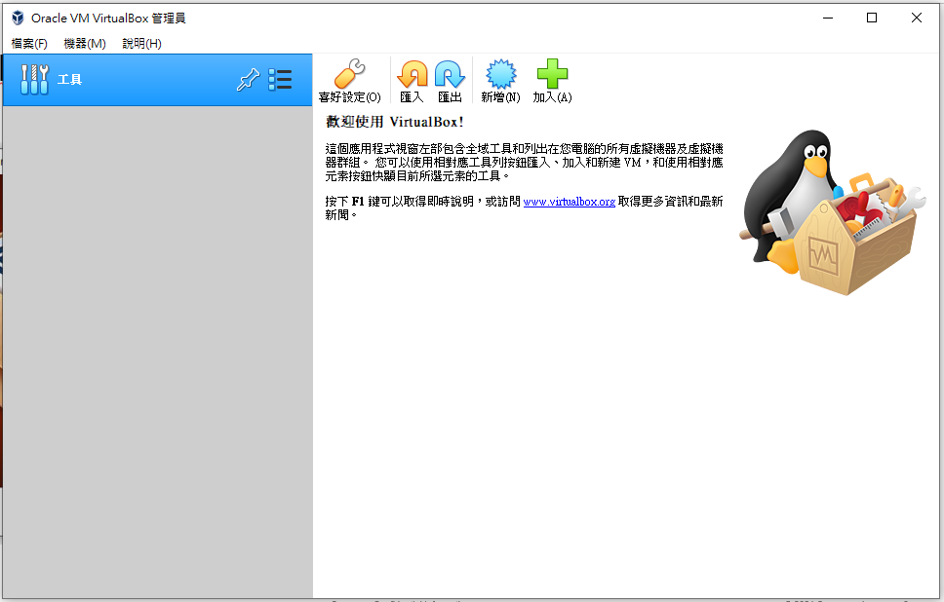
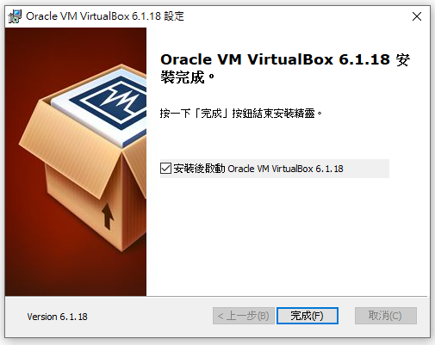
VirtualBox Installation

Slide 8
Install Cygwin

Slide 9
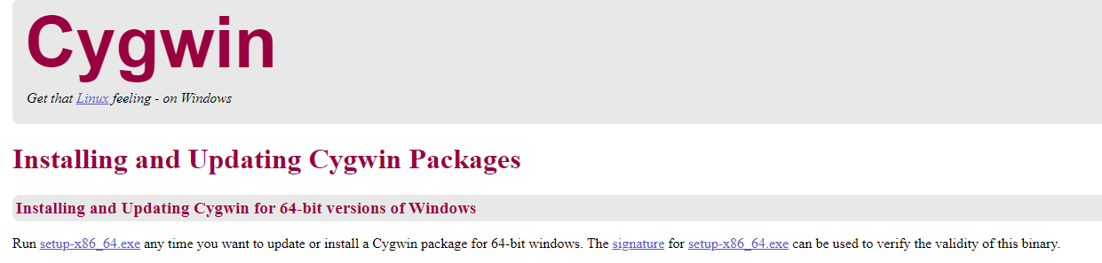
Cygwin64 installation
Go to https://cygwin.com/install.html

Slide 10
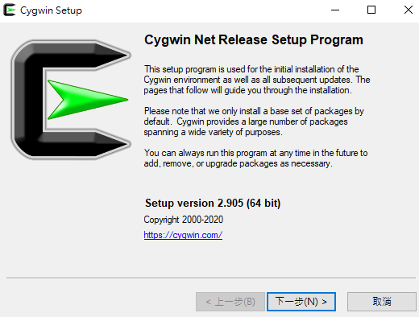
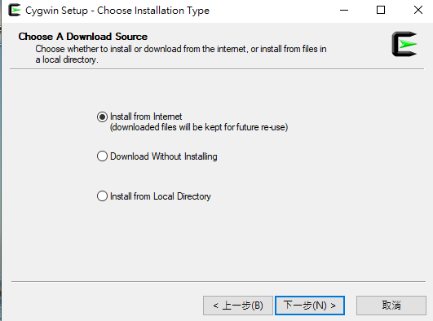
Cygwin64 installation

Slide 11
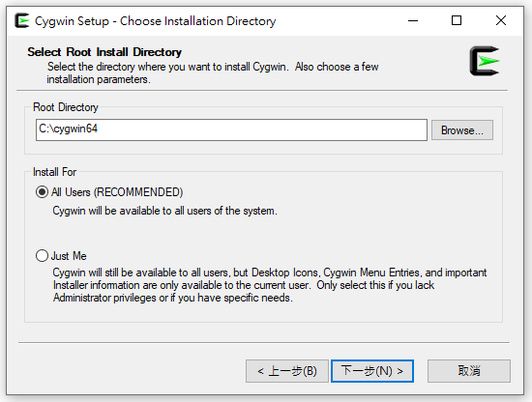
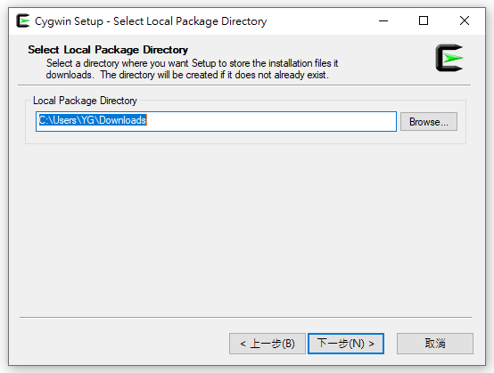
Cygwin64 installation

Slide 12
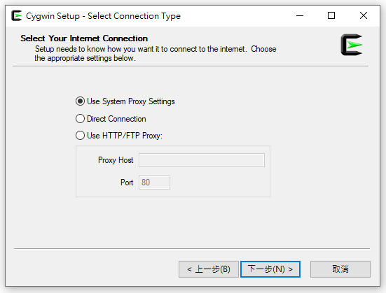
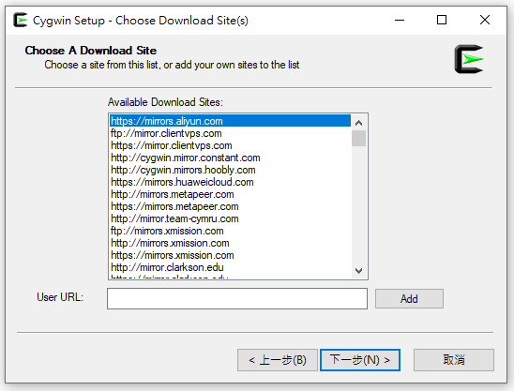
Cygwin64 installation

Slide 13
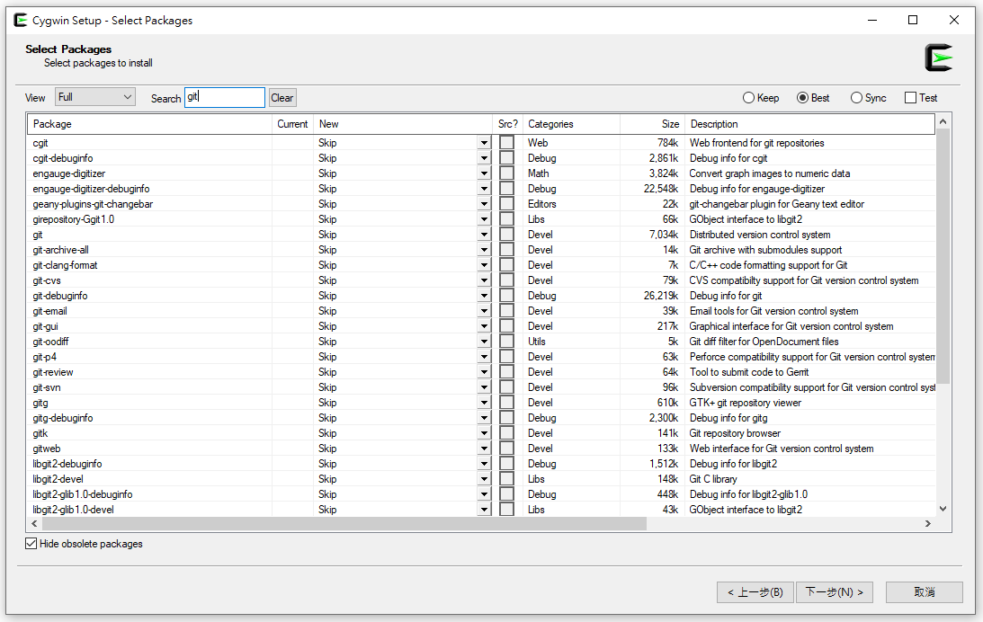
Cygwin64 installation
Search: git , xxd, make, unzip, curl

Slide 14
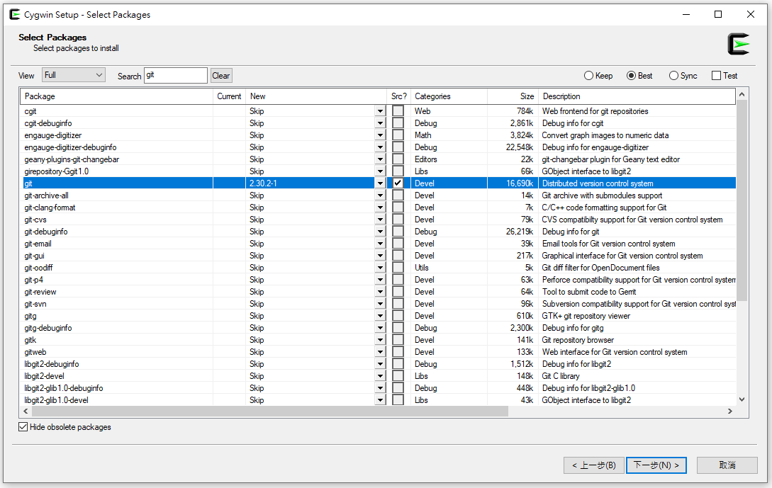

Cygwin64 installation
1. 按 選擇最新版本
2. 打勾
3. 請重複以上步驟在Search的欄位依序搜尋: git, xxd, make, unzip, curl 且選擇版本&打勾
4. 上述完成後再按

Slide 15
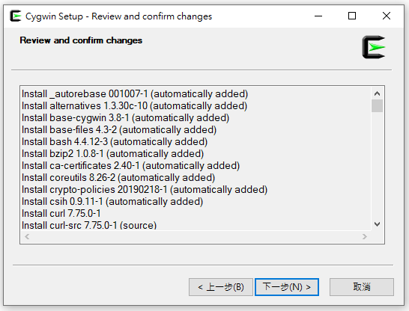
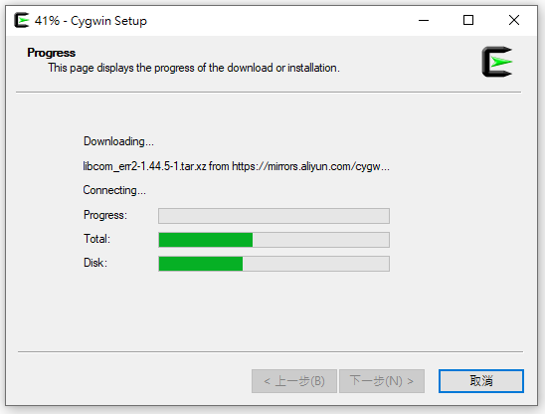
Cygwin64 installation

Slide 16
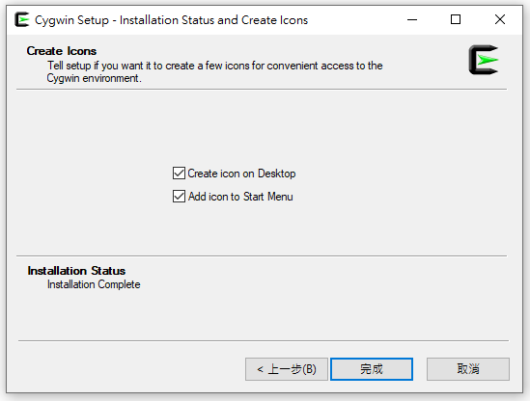
Cygwin64 installation

Slide 17
Install Teraterm

Slide 18
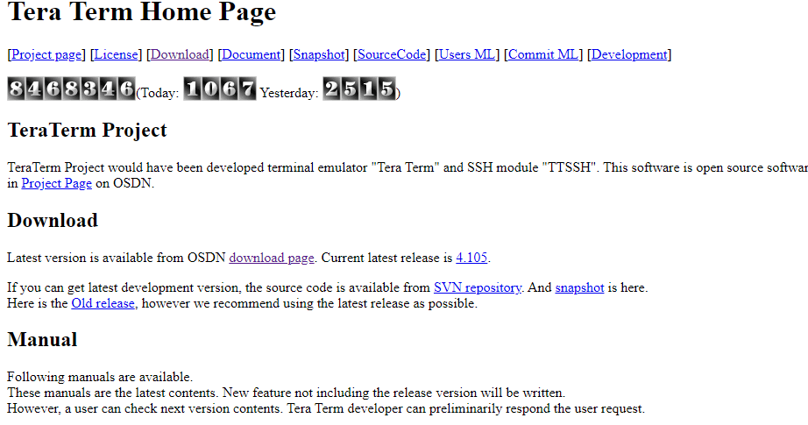
Teraterm Installation
Go to https://ttssh2.osdn.jp/index.html.en

Slide 19
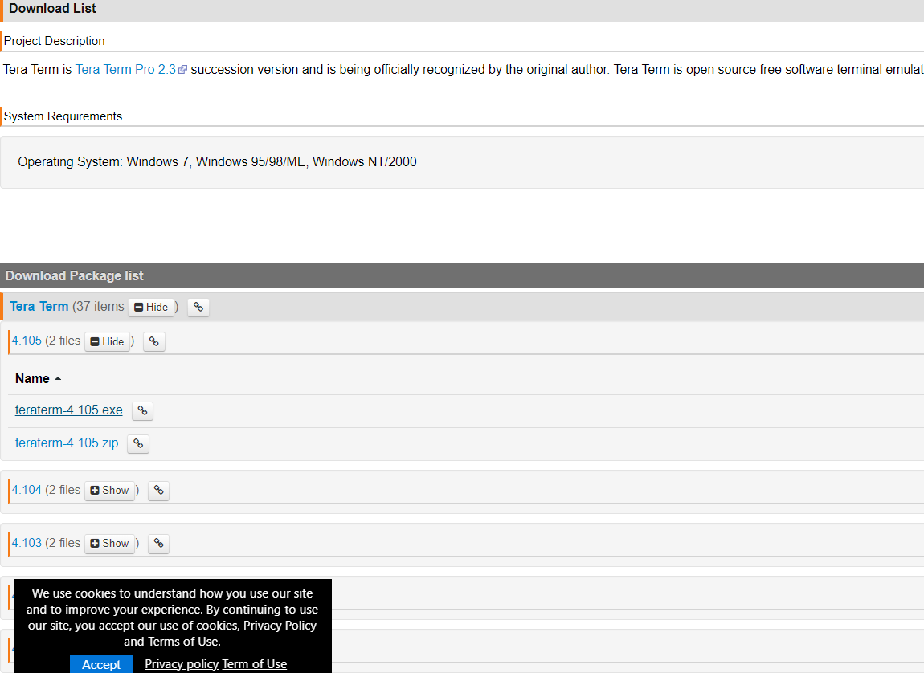
Teraterm Installation
Download teraterm-4 .105.exe

Slide 20
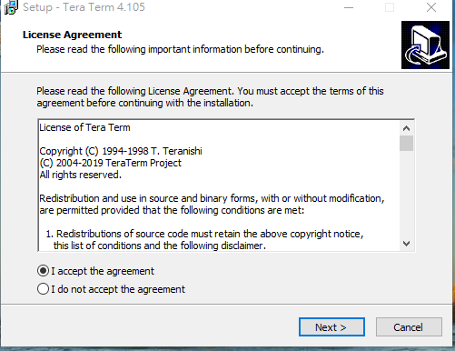
Teraterm Installation
Accept the agreement after reading it and select next

Slide 21
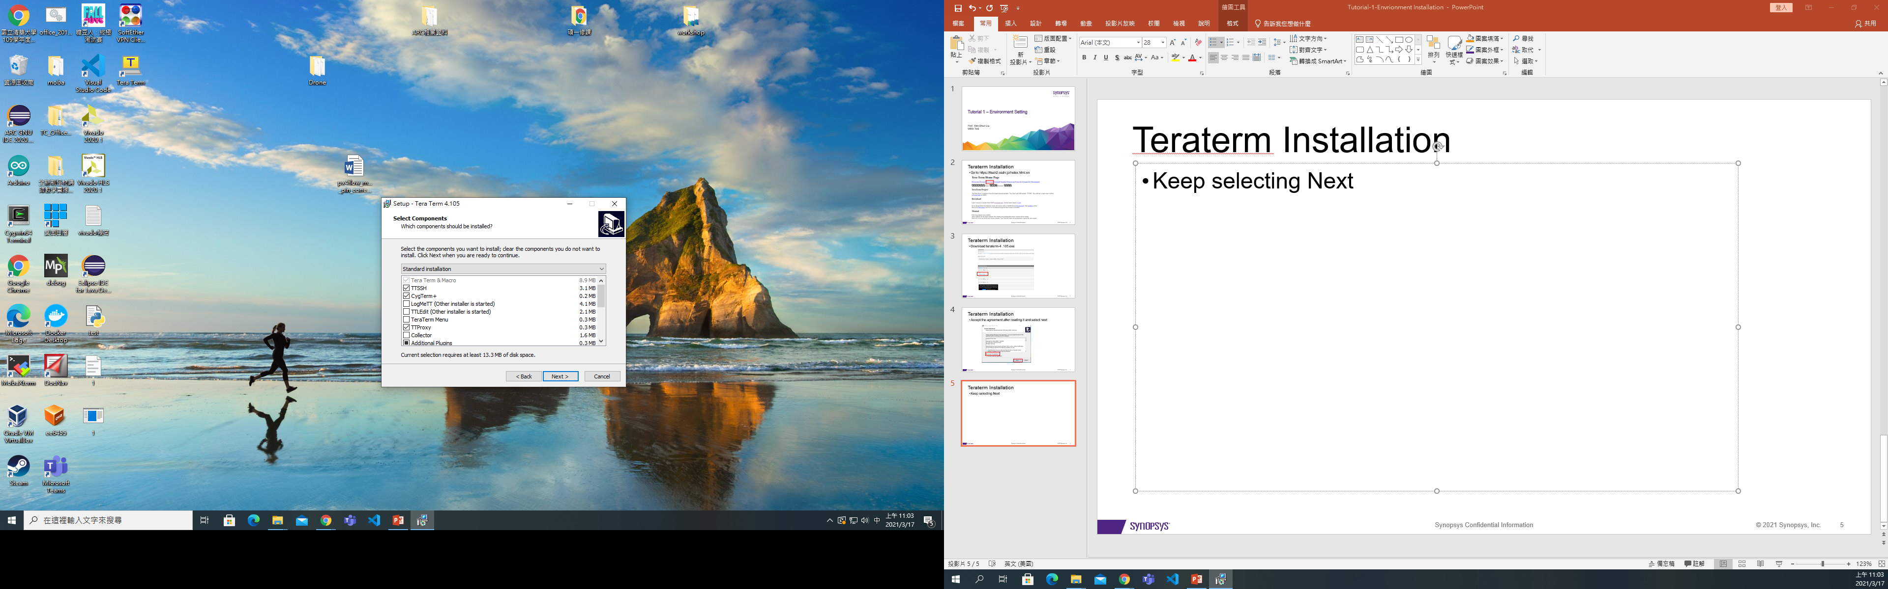
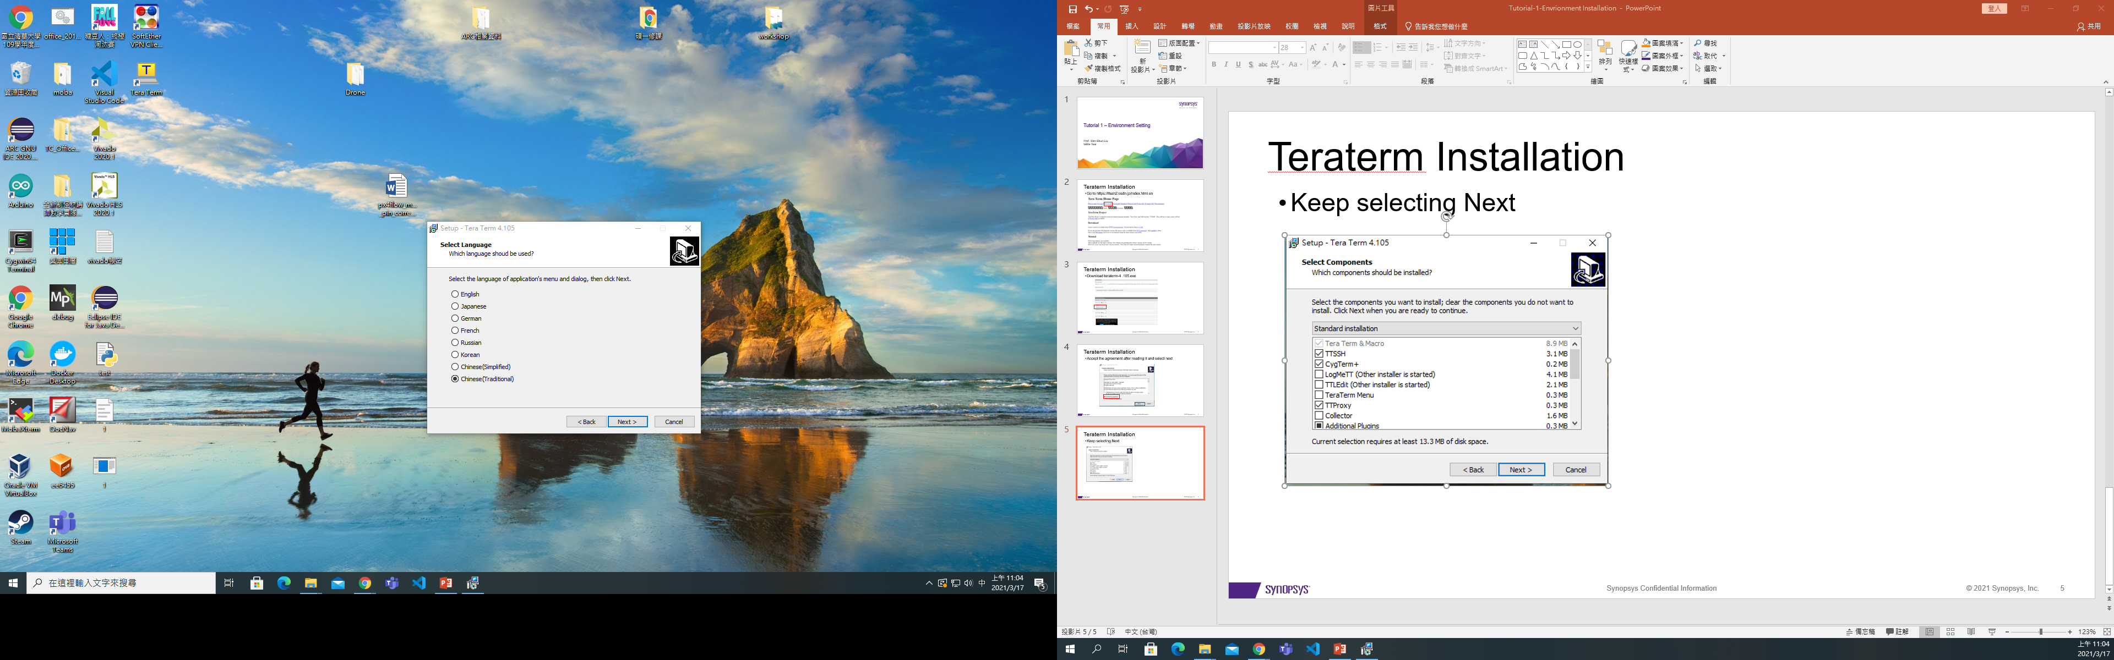
Teraterm Installation
Keep selecting Next
English or Chinese(Traditional) is recommended in this workshop

Slide 22
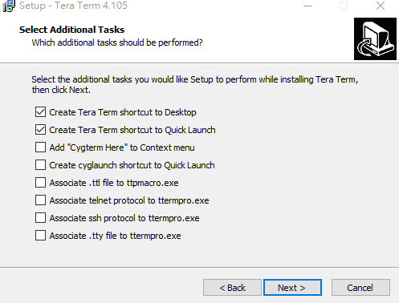
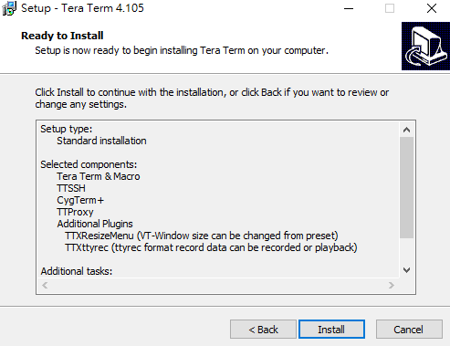
Teraterm Installation
Keep selecting Next and install

Slide 23
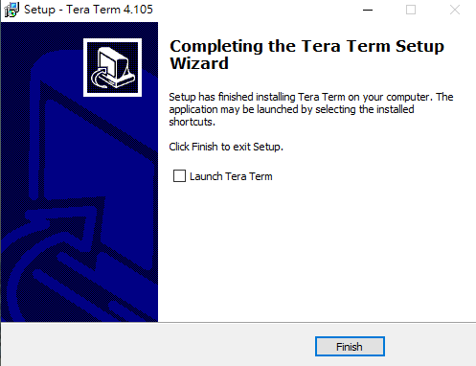
Teraterm Installation
Done

Slide 24
Install ARC GNU ToolChain

Slide 25
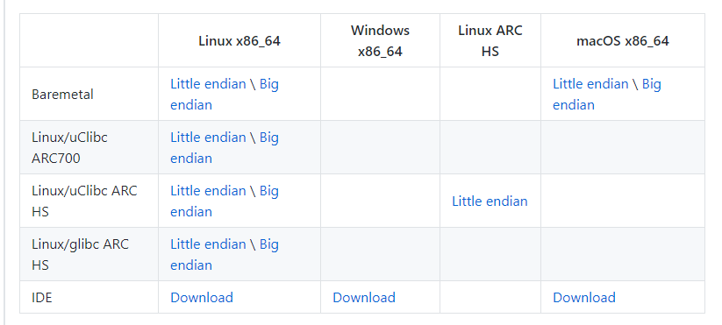
Installation of ARC GNU ToolChain
Step 1 – Go to the download page : https://github.com/foss-for-synopsys-dwc-arc-processors/toolchain/releases/

Slide 26
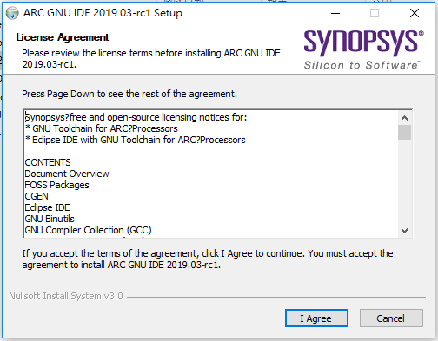
Installation of ARC GNU ToolChain
Step 2 – Double click the installation file and press I Agree

Slide 27
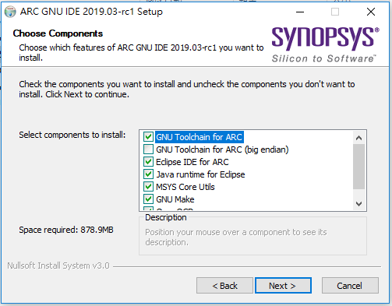
Installation of ARC GNU ToolChain
Step 3 – Press Next

Slide 28
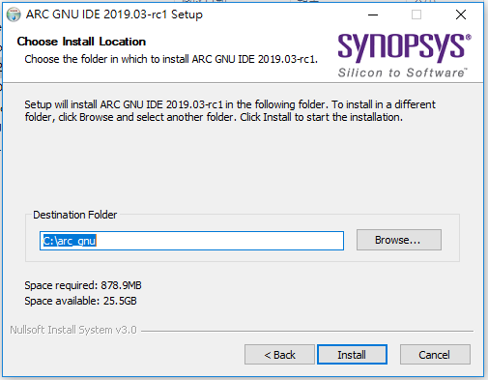
Installation of ARC GNU ToolChain
Step 4 – Press Install

Slide 29
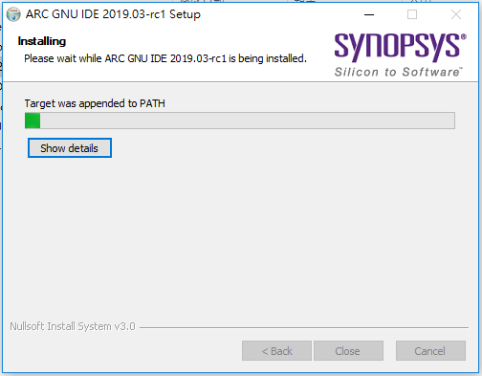
Installation of ARC GNU ToolChain
Step 5 – Start to install…

Slide 30
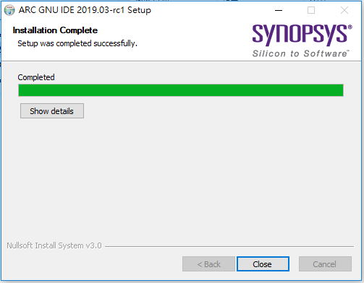
Installation of ARC GNU ToolChain
Step 6 – Press close and complete the installation

Slide 31
Install VScode

Slide 32
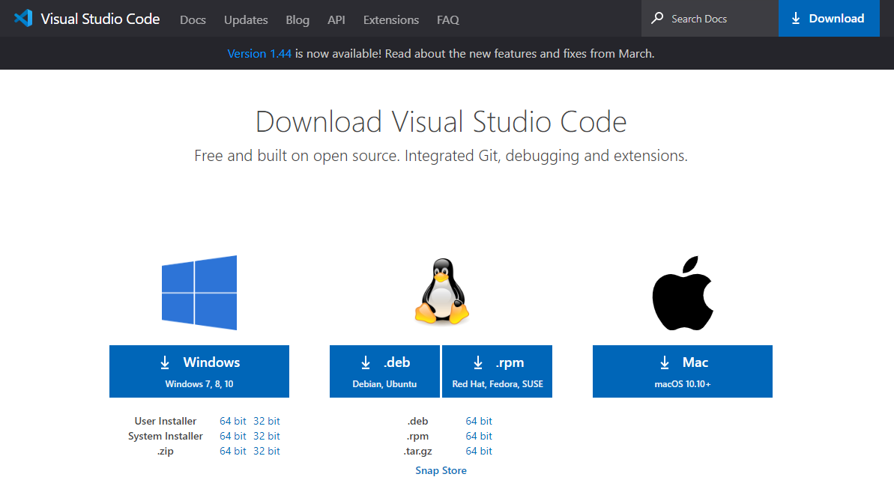
Installation of VScode
Step 1 – Go to download page of VScode : https://code.visualstudio.com/download and press download

Slide 33
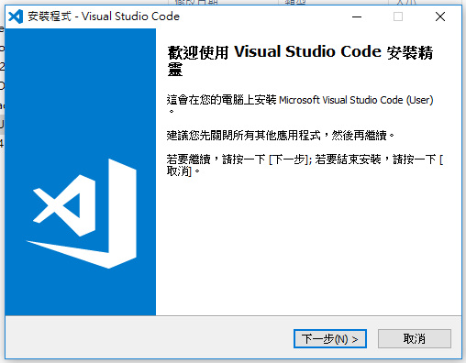
Installation of VScode
Step 2 – Double click the installation file and press next

Slide 34
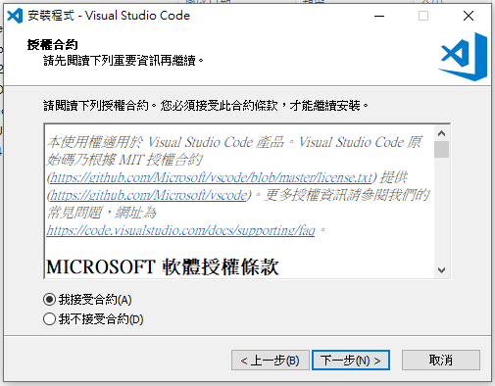
Installation of VScode
Step 2 – Accept the contract and press next

Slide 35
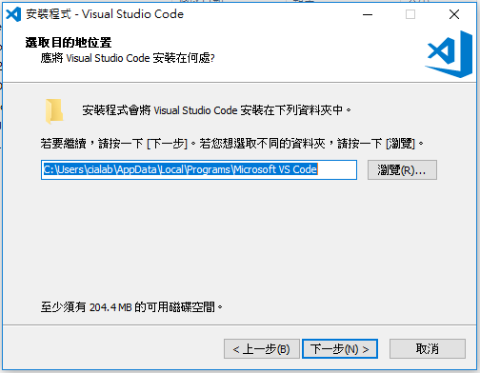
Installation of VScode
Step 3 – Press next

Slide 36
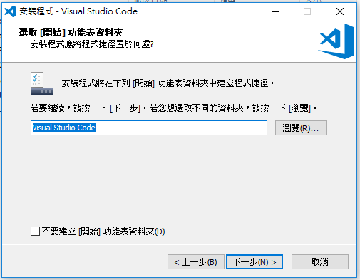
Installation of VScode
Step 4 – Press next

Slide 37
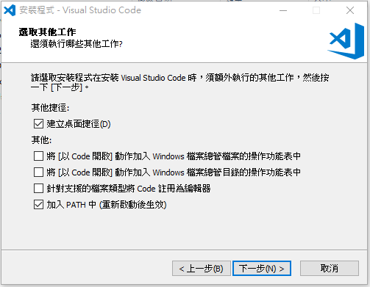
Installation of VScode
Step 5 – Press next

Slide 38
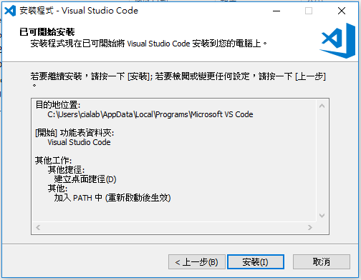
Installation of VScode
Step 6 – Press install

Slide 39
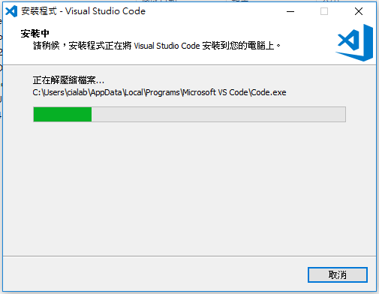
Installation of VScode
Step 7 – Start to install…

Slide 40

Installation of VScode
Step 8 – Press finish

Slide 41
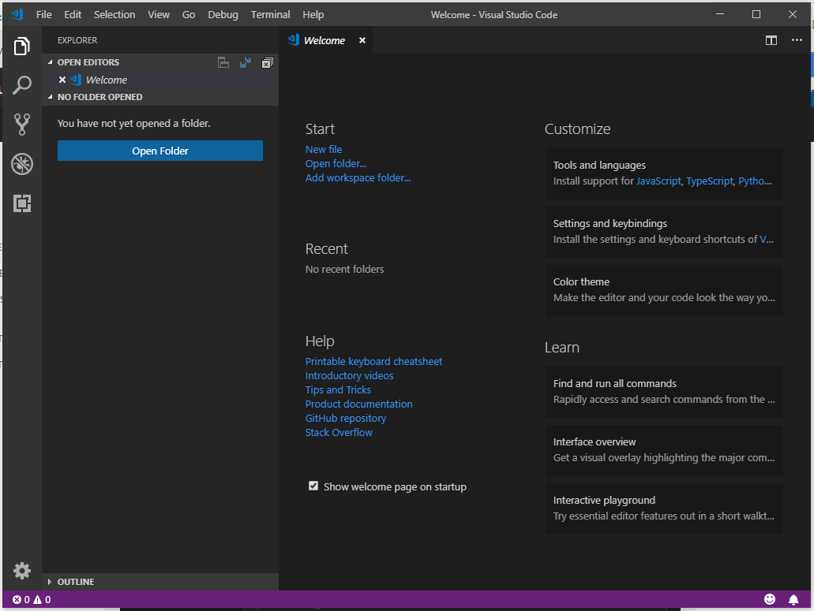
Installation of VScode
Step 9 – Try to open the VScode

